Slide 1

Data Communication and Network
Department of Network and Security
Threats
Isuru Sri Bandara
isuru.s@nsbm.ac.lk

Slide 2
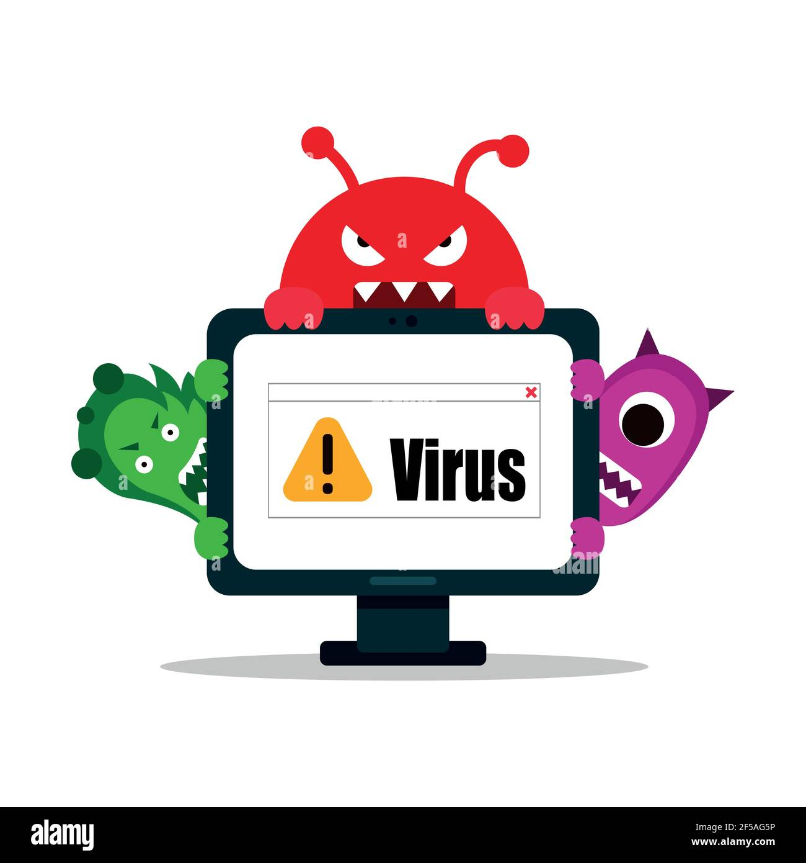
Virus
A virus has similarities to biological viruses. Once find a host, it will replicate and distribute them attached to a file.
Virus classifications,
Boot Sector Virus
File Deleting Viruses
Mass Mailer Viruses
Macro viruses
Polymorphic Viruses
Armored Viruses
Stealth viruses
Retrovirus
ILOVEYOU virus, 2000: This malware virus impacted millions of computers around the globe and was downloaded by clicking on an attachment called “LOVE-LETTER-FOR-YOU.TXT.vbs” and from an email with the subject line “ILOVEYOU.”

Slide 3
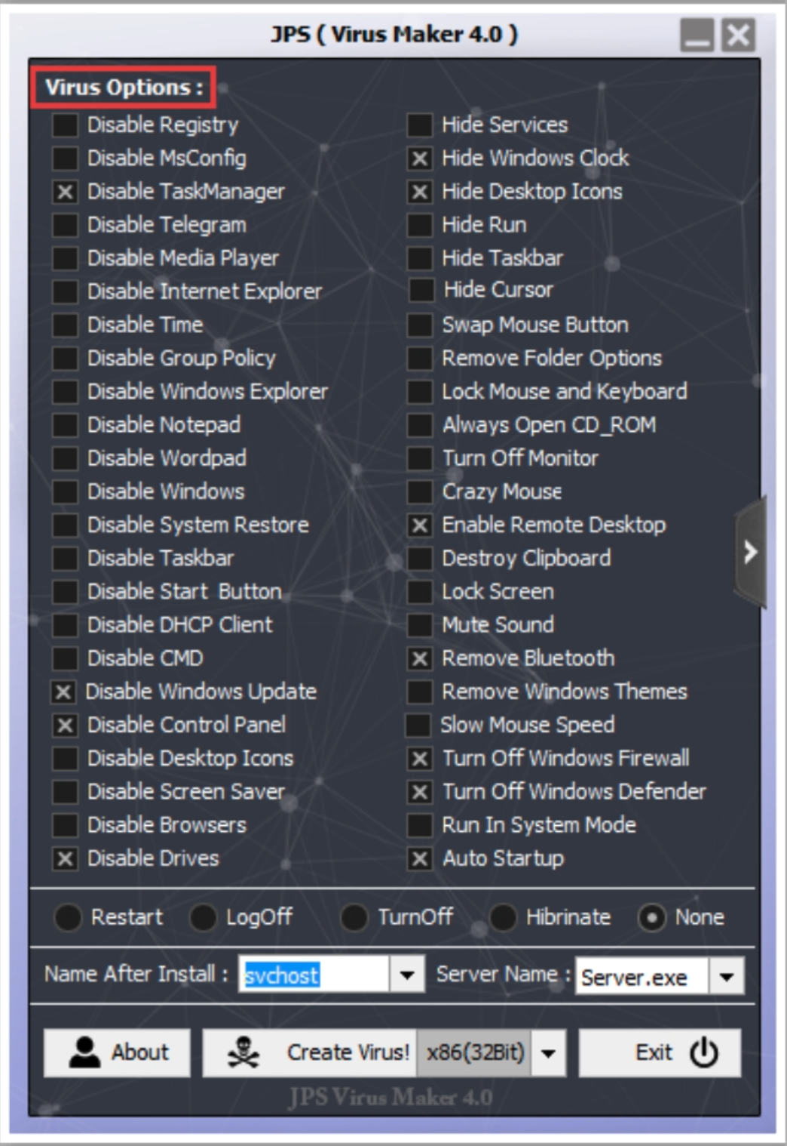
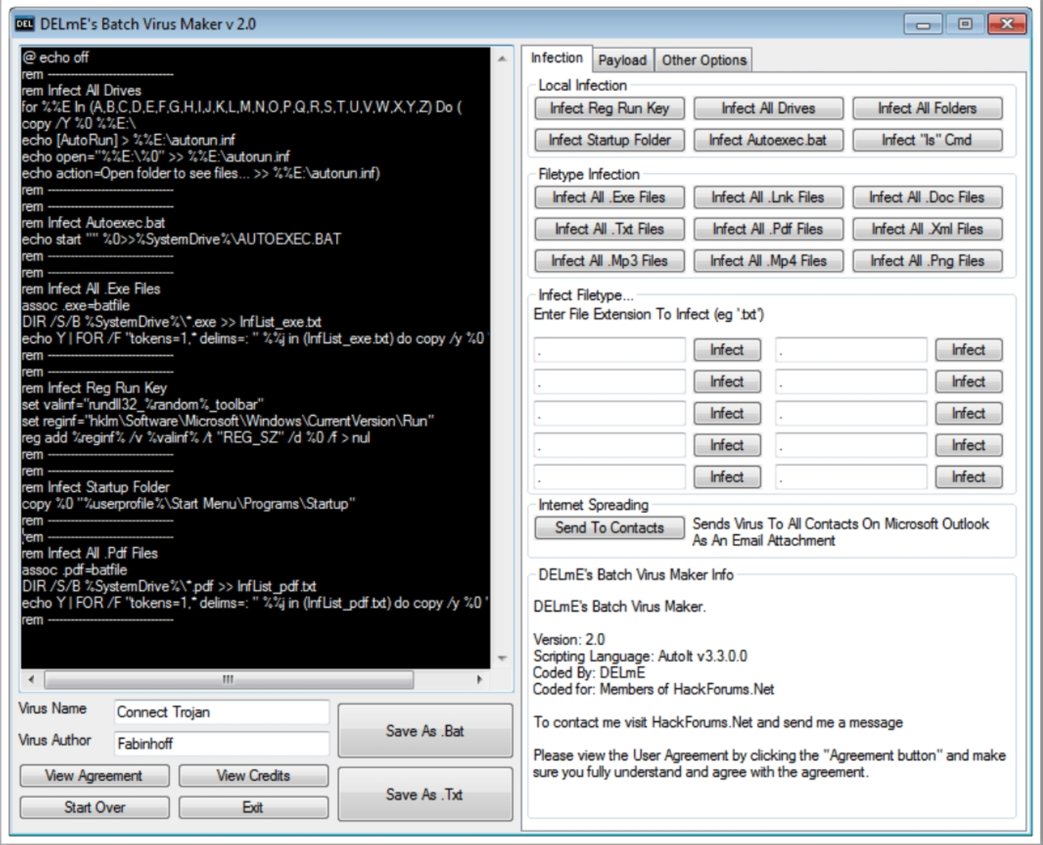
Virus Maker Tool

Slide 4
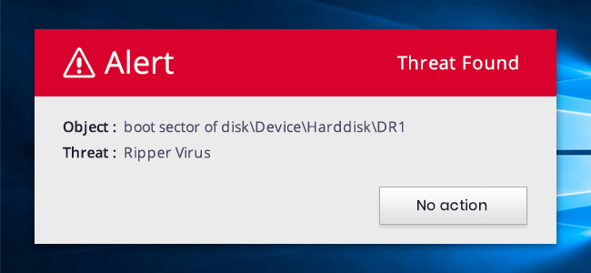
Virus
1. Boot Sector Virus
Virus infects the first sector of the hard drive, where the Master Boot Record (MBR) is stored. The Master Boot Record (MBR) stores the disk's primary partition
Examples :- Elk Cloner, Brain, Stoned, Parity Boot Virus, Michelangelo, and Angelina

Slide 5

Virus
2. File Deleting Viruses
designed to delete critical files which are the part of
Operating System or data files like CIH viruses (also known as the Chernobyl virus) it’s threatened to delete files automatically and erase the core system code kept in flash memory on the motherboard of certain types of computers

Slide 6

Virus
3. Mass Mailer Viruses
Mass Mailer Viruses search e-mail programs like MS outlook for e-mail addresses which are stored in the address book and replicate by e-mailing themselves to the addresses stored in the address book of the e-mail program.
ILOVEYOU virus, 2000: This malware virus impacted millions of computers around the globe and was downloaded by clicking on an attachment called “LOVE-LETTER-FOR-YOU.TXT.vbs” and from an email with the subject line “ILOVEYOU.”

Slide 7
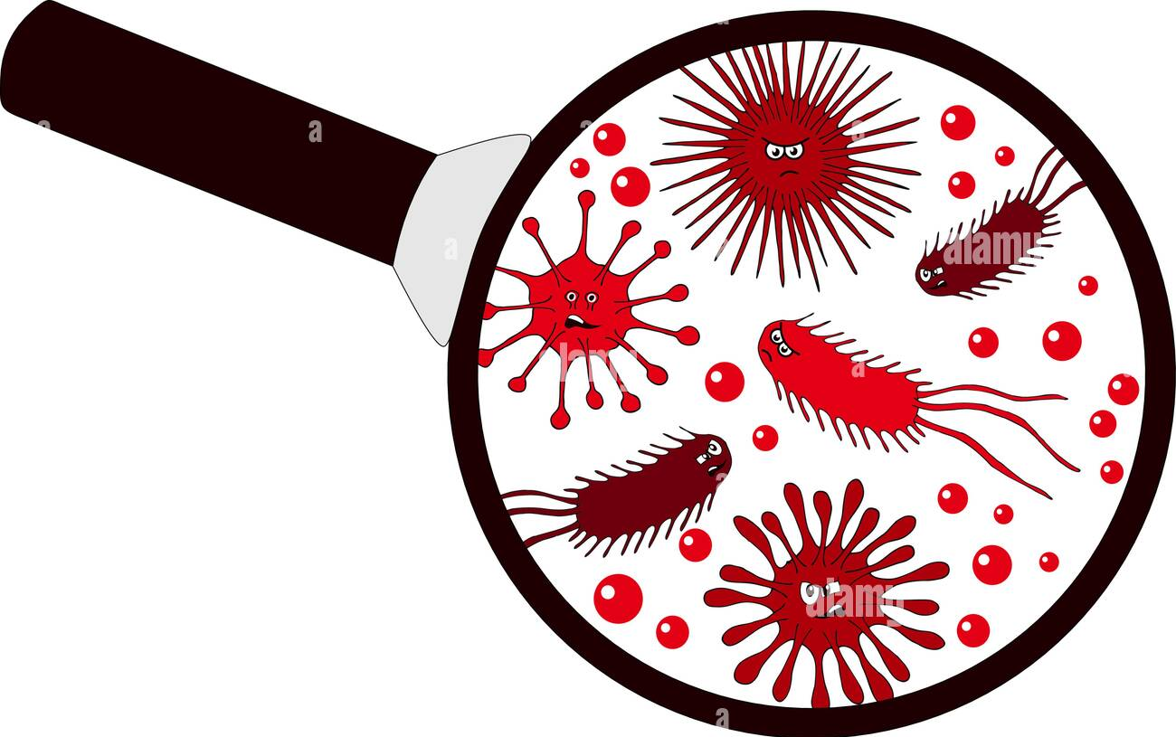
Virus
4. Macro viruses
Macro viruses are written by using the Macro programming languages like VBA, which is a feature of MS office package. A macro is a way to automate and simplify a task that you perform repeatedly in MS office suit (MS Excel, MS word etc). These macros are usually stored as part of the document or spreadsheet and can travel to other systems when these files are transferred to another computers.
Example Melissa Virus

Slide 8
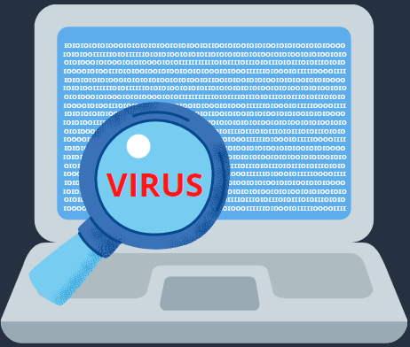
Virus
5. Polymorphic Viruses
It has the capability to change their appearance and change
their code every time they infect a different system. This helps the Polymorphic Viruses to hide from anti-virus software.
Example Ursnif (also known as Gozi)

Slide 9
Virus
6. Armored Viruses:
This type of viruses that are designed and written to make itself difficult to detect or analyze. An Armored Virus may also have the ability to protect itself from antivirus programs, making it more difficult to disinfect.
Example Whale virus

Slide 10

Worms
"self-replicating programs that spread with no human intervention after they are started."
As defined in the "Security of the Internet" report released in 1996 by the CERT Division of the Software Engineering Institute at Carnegie Mellon University

Slide 11
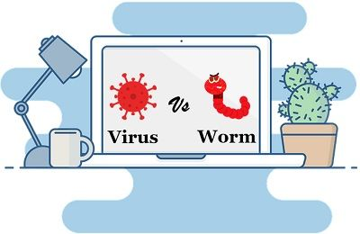
Virus vs Worms
"self-replicating programs, but usually require some action on the part of the user to spread inadvertently to other programs or systems."

Slide 12
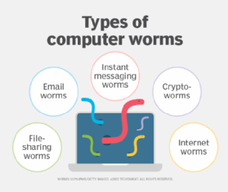
Worms
Email worms
File-sharing worms
Crypto worms
Internet worms
Instant messaging worms

Slide 13
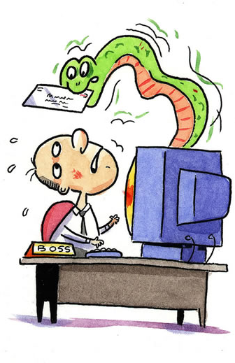
Email worms
Email worms work by creating and sending outbound messages to all the addresses in a user's contact list. The messages include a malicious executable file that infects the new system when the recipient opens it.

Slide 14
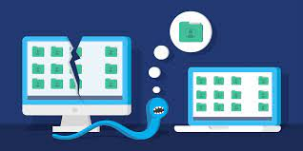
File-sharing worms
File-sharing worms copy themselves into shared folders and spread through peer-to-peer file-sharing networks. Worm authors often disguise these malicious programs as media files.

Slide 15

Crypto worms
Crypto worms work by encrypting data on the victim's system. Perpetrators can use this type of worm in ransomware attacks, where they follow up with the victim and demand payment in exchange for a key to decrypt the files.

Slide 16

Instant messaging worms
Like email worms, instant messaging worms are masked by attachments or links, which the worm continues to spread to the infected user's contact list. The only difference is that instead of arriving in an email, it comes as an instant message on a chat service.

Slide 17
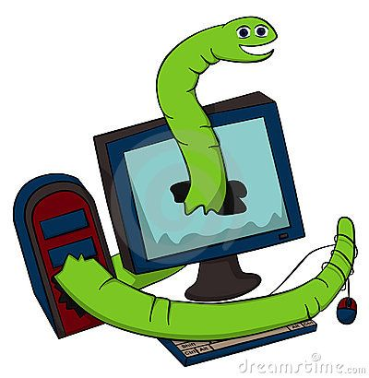
Internet worms
Some computer worms specifically target popular websites with poor security. If they can infect the site, they can infect a computer accessing the site.
From there, internet worms spread to other devices that the infected computer connects to through the internet and private network connections

Slide 18

Trojan Horse
A Trojan Horse Virus is a type of malware that downloads
onto a computer disguised as a legitimate program.
Actions include:
Deleting data
Blocking data
Modifying data
Copying data
Disrupting the performance of computers or computer networks

Slide 19
Trojan Horse
Type of Trojan horse
Backdoor Trojans
DDoS Trojans
Data Sending Trojans
Destructive Trojans
Proxy Trojans
Security software disabler Trojans

Slide 20
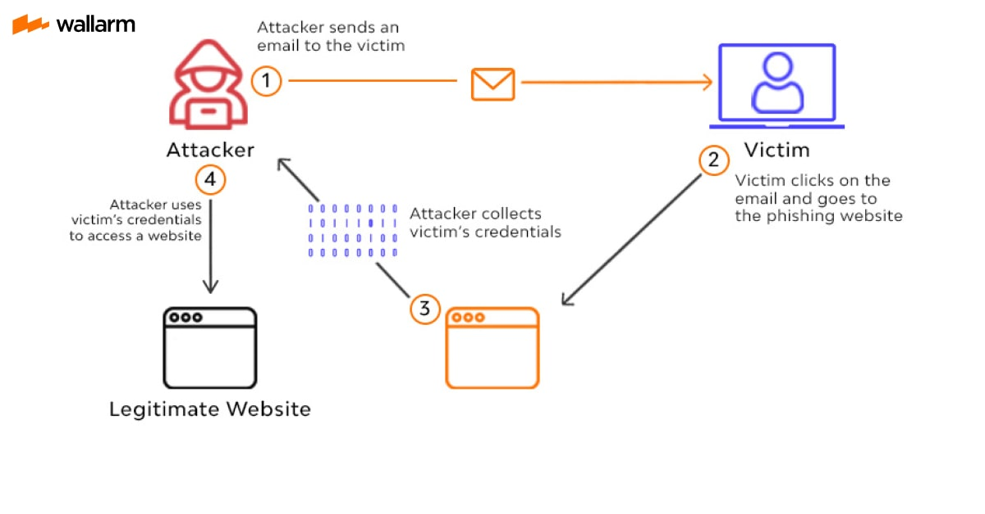
Phishing Attack
Phishing attacks are one of the most prominent widespread types of cyberattacks. It is a type of social engineering attack wherein an attacker impersonates to be a trusted contact and sends the victim fake mails.

Slide 21
Denial-of-Service Attack (DOS)
A Denial-of-Service Attack is a significant threat to companies. Here, attackers target systems, servers, or networks and flood them with traffic to exhaust their resources and bandwidth.
Distributed Denial-of-Service(DDOS)
when attackers use multiple compromised systems to launch this attack.

Slide 22
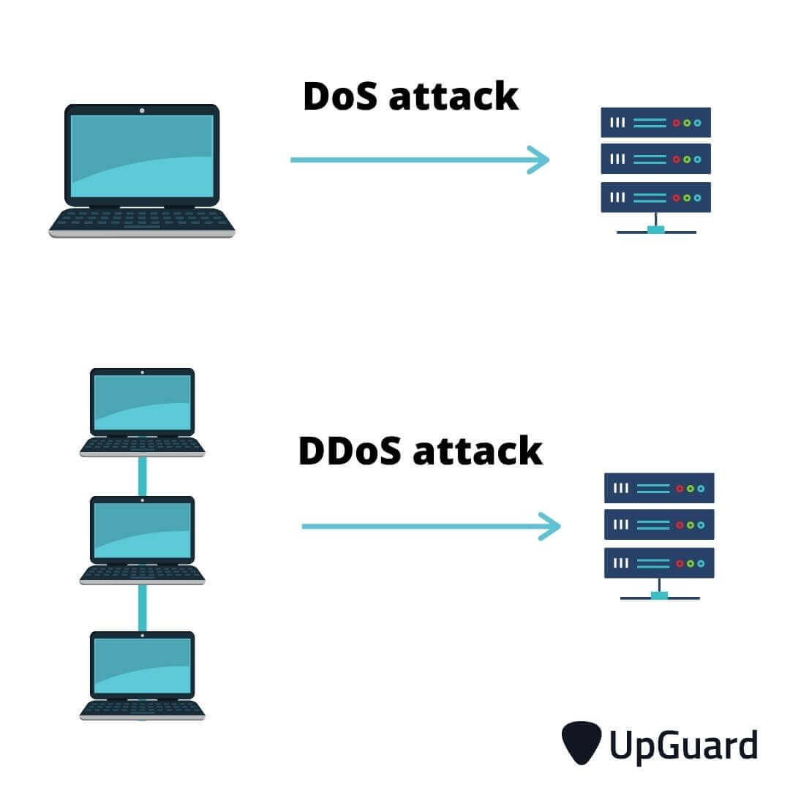
Denial-of-Service Attack (DOS)

Slide 23
Cyber-Terrorists – Attacks
Kaseya, a US-based provider of remote management software, experienced a supply chain attack, which was made public on July 2, 2021. The company announced that attackers could use its VSA product to infect customer machines with ransomware.
The attack was reported to be highly sophisticated, chaining together several new vulnerabilities discovered in the Kaseya product: CVE-2021-30116 (credentials leak and business logic flaw), CVE-2021-30119 (XSS), and CVE-2021-30120 (two-factor authentication flaw). The malware exploiting these vulnerabilities was pushed to customers using a fake software update labelled “Kaseya VSA Agent Hot Fix”.

Slide 24

Protection Measures

Slide 25
Evolving Detection Measures
In response to the malware threat, a whole industry has emerged around antivirus solutions
Scrutinize the emails/application you receive/install.
Update your passwords regularly.
With the rise of crimeware, the security industry’s activities move increasingly towards a policing role
Be mindful of the security of the website you are using. Use encryption on your devices.
Refrain from using public Wi-Fi networks.

Slide 26
Evolving Detection Measures
Use an Intrusion detection system, as they design it to detect unauthorized access to a network.
Run a traffic analysis to identify malicious traffic.
Outsource DDoS prevention to cloud-based service providers

Slide 27

Thank You

